Slide 1
Review

Slide 2
Program Development
The mechanics of developing a program include several activities:
writing the program in a specific programming language (such as Java)
translating the program into a form that the computer can execute
investigating and fixing various types of errors that can occur
Software tools can be used to help with all parts of this process

Slide 3
Language Levels
There are four programming language levels:
machine language
assembly language
high-level language
fourth-generation language
Each type of CPU has its own specific machine language
The other levels were created to make it easier for a human being to read and write programs

Slide 4
Programming Languages
Each type of CPU executes only a particular machine language
A program must be translated into machine language before it can be executed
A compiler is a software tool which translates source code into a specific target language
Sometimes, that target language is the machine language for a particular CPU type
The Java approach is somewhat different

Slide 5
Java Translation
The Java compiler translates Java source code into a special representation called bytecode
Java bytecode is not the machine language for any traditional CPU
Bytecode is executed by the Java Virtual Machine (JVM)
Therefore Java bytecode is not tied to any particular machine
Java is considered to be architecture-neutral

Slide 6
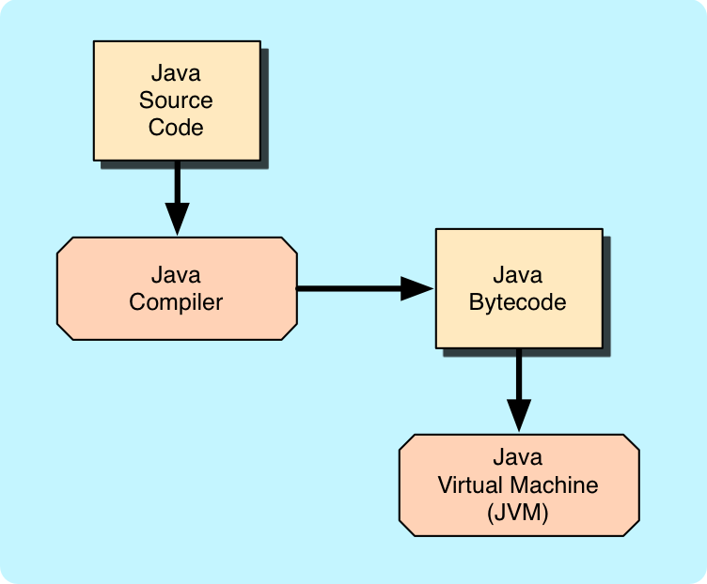
Java Translation

Slide 7
Development Environments
There are many programs that support the development of Java software, including:
Java Development Kit (JDK)
Eclipse
NetBeans
BlueJ
jGRASP
Though the details of these environments differ, the basic compilation and execution process is essentially the same

Slide 8
Quick Check
What are JVM, JRE, and JDK?
The Java Virtual Machine's (JVM) function is to load the appropriate class files for executing a Java Program, and then to execute it.
The Java Runtime Environment (JRE) includes the JVM, as the JRE provides some standard libraries and the JVM which can be used to execute a Java program.
The Java Developers Kit (JDK) also includes the JVM, standard class libraries, and several other tools that a developer needs in order to create a Java program.
http://javajeeexamples.com/difference-jvm-jre-jdk/
https://www.geeksforgeeks.org/differences-jdk-jre-jvm/

Slide 9
Install
http://docs.oracle.com/javase/7/docs/webnotes/install/index.html
https://docs.oracle.com/javase/10/install/overview-jdk-10-and-jre-10-installation.htm#JSJIG-GUID-8677A77F-231A-40F7-98B9-1FD0B48C346A
http://www.youtube.com/watch?v=NoPxZejnp-E
https://www.youtube.com/watch?v=_YmuR4aw9pM
Compile & Run a program
javac
java

Slide 10
Syntax and Semantics
The syntax rules of a language define how we can put together symbols, reserved words, and identifiers to make a valid program
The semantics of a program statement define what that statement means (its purpose or role in a program)
A program that is syntactically correct is not necessarily logically (semantically) correct
A program will always do what we tell it to do, not what we meant to tell it to do

Slide 11
Errors
A program can have three types of errors
The compiler will find syntax errors and other basic problems (compile-time errors)
If compile-time errors exist, an executable version of the program is not created
A problem can occur during program execution, such as trying to divide by zero, which causes a program to terminate abnormally (run-time errors)
A program may run, but produce incorrect results, perhaps using an incorrect formula (logical errors)

Slide 12
Basic Program Development
Edit and
save program
errors?
Compile program
errors?
Execute program and
evaluate results

